Slide 1
G O T H A M
Group members :
ARIF FAYSAL
ID : 011-121-090
Tansim Mariyam Mukur
ID : 011-131-081

Slide 2
Project introduction:
We have created Gotha city, which is under protection of the Dark Knight with the help of OpenGl.
This 2D project contains parts of the city such as Buildings, The BatSignal in the sky, BatMobile or the BatCar on the road.
OpenGL basics functions–Animate, PushPop matrix, Translate, Rotate has been used.

Slide 3
Individual Tasks :
Tasnim :
Coordinate set for the Gotham city’s buildings and BatCar.
Construction of the buildings by coding.
Applying translation on the BatSignal.
Arif :
Coordinate set for BatSignal, Basic Layouts, Design.
Construction of BatCar.
Applying translate Rotate on Weapon, BatCar, Turbine, Boat.

Slide 4
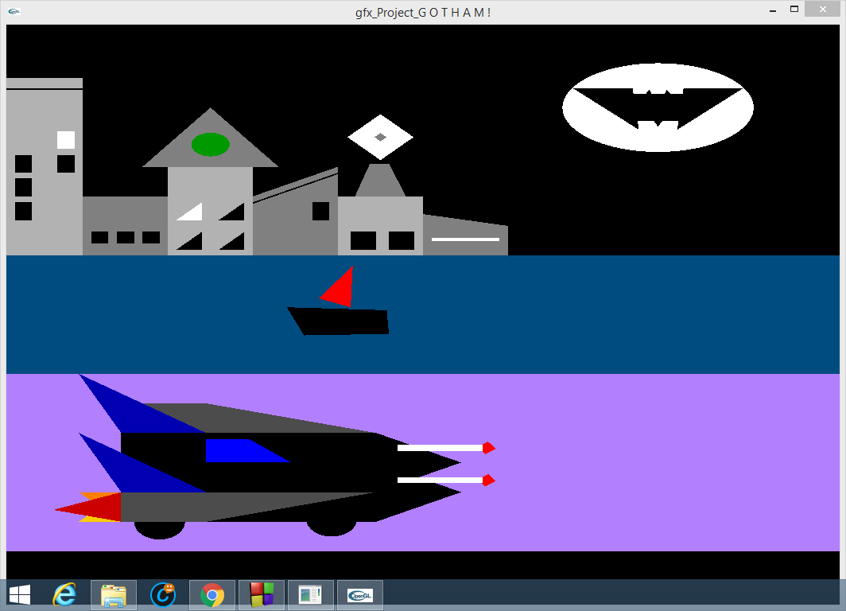
SNAPS :

Slide 5
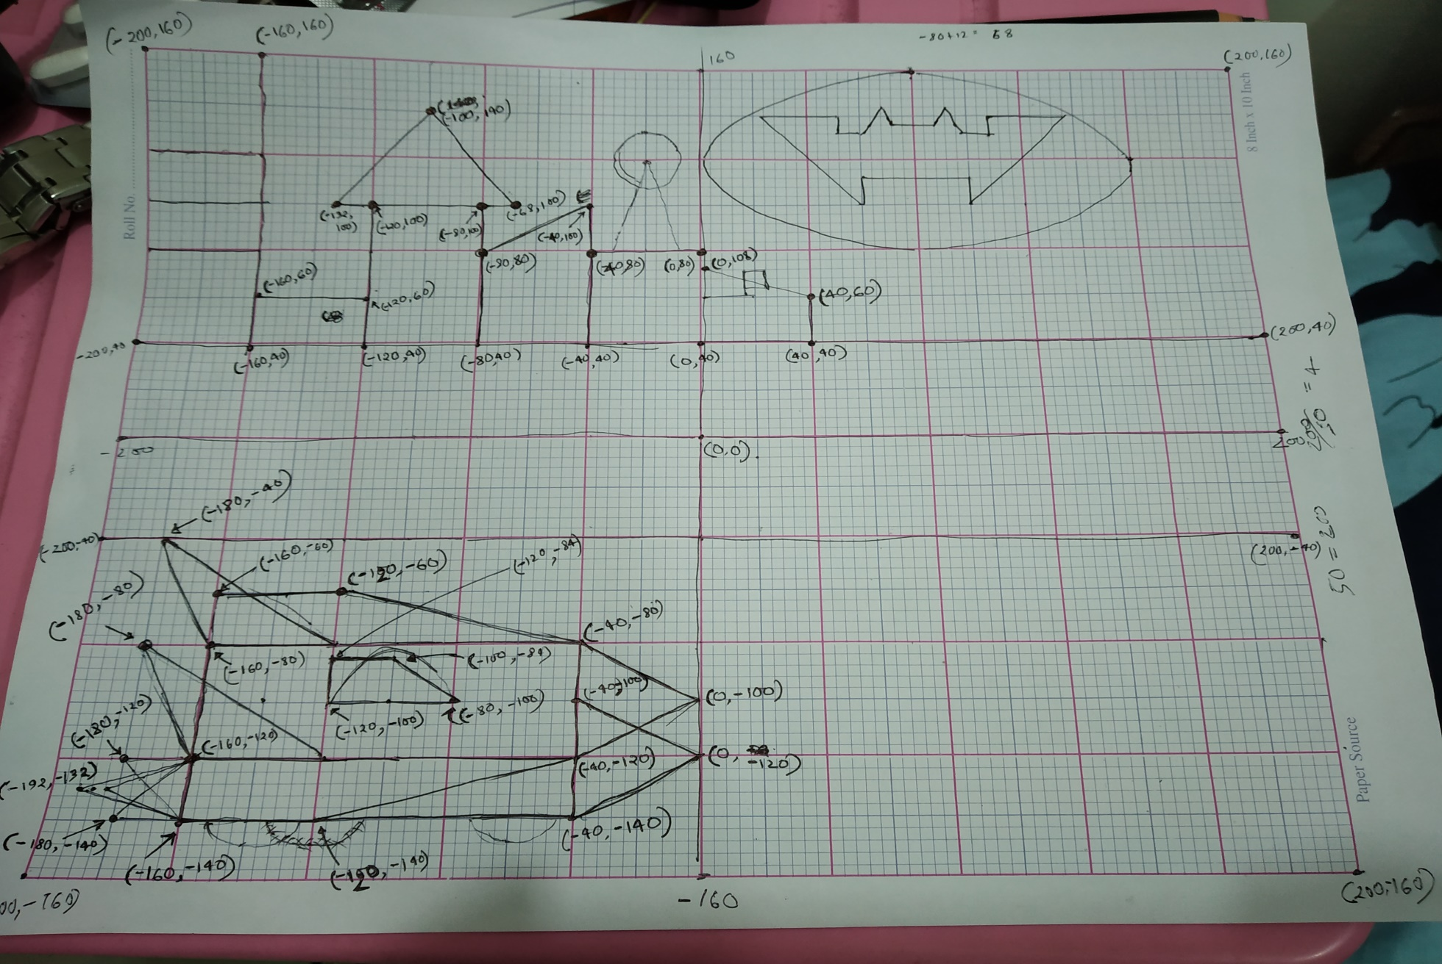
SNAPS :

Slide 6

Thank You

